Slide 1
Performance optimization of badly written SQL code Enhancing Database Efficiency for Faster, More Scalable Applications
Uwe Ricken
https://github.com/uricken1964/Workshop---Making-Bad-Codes-Better

Slide 2




Uwe Ricken db Berater GmbH
I am working with IT-systems since early 1990's and with the main focus on Microsoft SQL Server since version 6.0. I started with development of database applications in 1998 with a professional CRM-System based on Microsoft products (Microsoft Office and Microsoft SQL Server).
Since 2008 I'm focused exclusively on Microsoft SQL Server and I was working in 3rd level support teams for enterprise companies, banks and insurances.
Since May 2013 I'm a Microsoft Certified Master: SQL Server 2008 which was an amazing way into the depth of Microsoft SQL Server.
In July 2013 I have been awarded with the MVP Award for Microsoft SQL Server.
www: http://www.db-berater.de
email: uwe.ricken@db-berater.de
blog: http://www.sqlmaster.de
LinkedIn: https://www.linkedin.com/in/uwericken

Slide 3
Break Times
09:00 – 10:30 Session
10:30 – 11:00 Coffee Break
11:00 – 12:30 Session
12:30 – 13:30 Lunch Break
13:30 – 15:00 Session
15:00 – 15:30 Coffee Break
15:30 – 16:45 / 17:00 Session

Slide 4
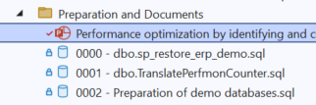
Action List
Download ERP_Demo Database https://www.db-berater.de/downloads/ERP_DEMO_2012.BAK
Download Workshop Solution https://github.com/db-berater/speedup-your-sql-code
Open the SSMS Project File in SSMS
Execute the following scripts
0000 - dbo.sp_restore_erp_demo.sql
0001 - Preparation of demo databases.sql
Check the version of the demo database SELECT * FROM ERP_Demo.dbo.get_database_help_info();;

Slide 5
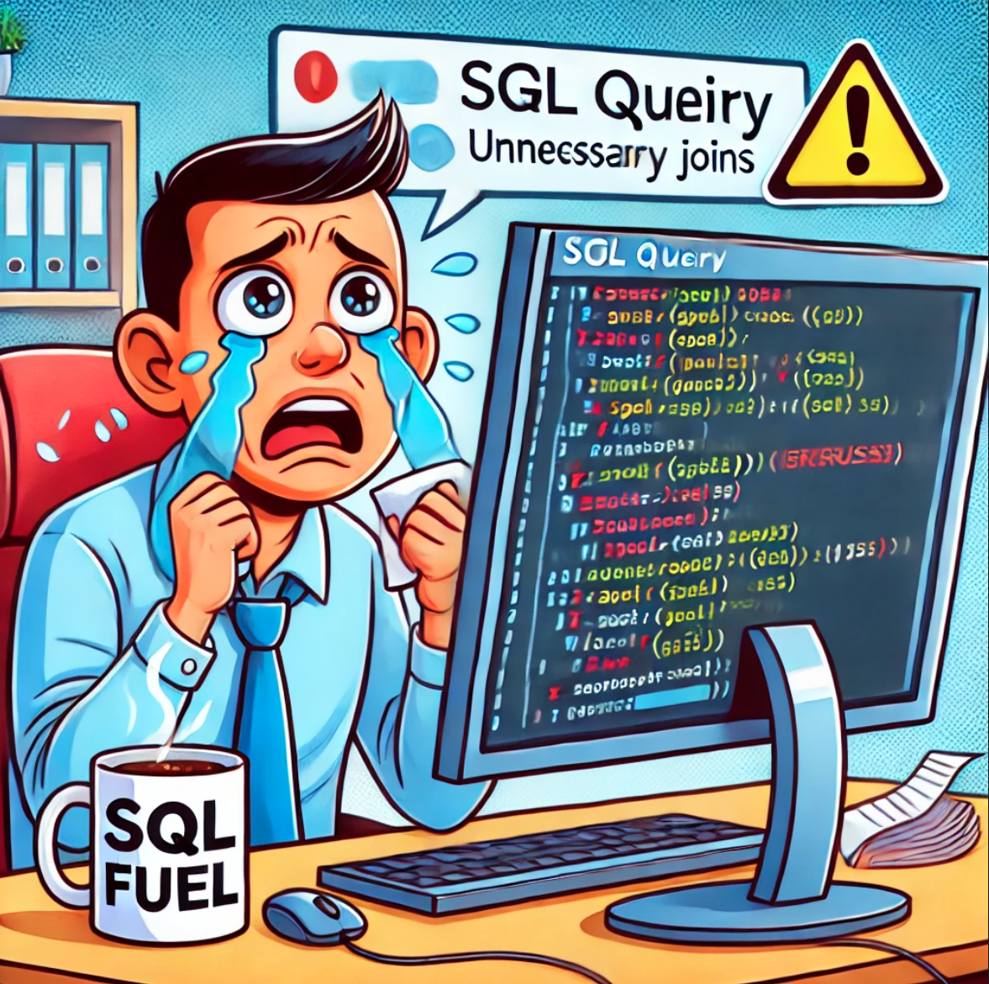
Make your SQL Code fast again
Why is SQL optimization important?
Performance Improvement
Efficient SQL code enhances database performance by reducing execution time and resource consumption.
Resource Utilization
Optimized SQL queries use fewer system resources like CPU, memory, and disk I/O for better scaling.
Scalability
Efficiently written SQL code can better handle increased data volume and user load.
Cost Savings
Reduced resource usage translates to cost savings, especially in cloud environments.
Reliability and Stability
Efficient queries are less likely to cause unexpected issues, such as timeouts or server crashes.

Slide 6
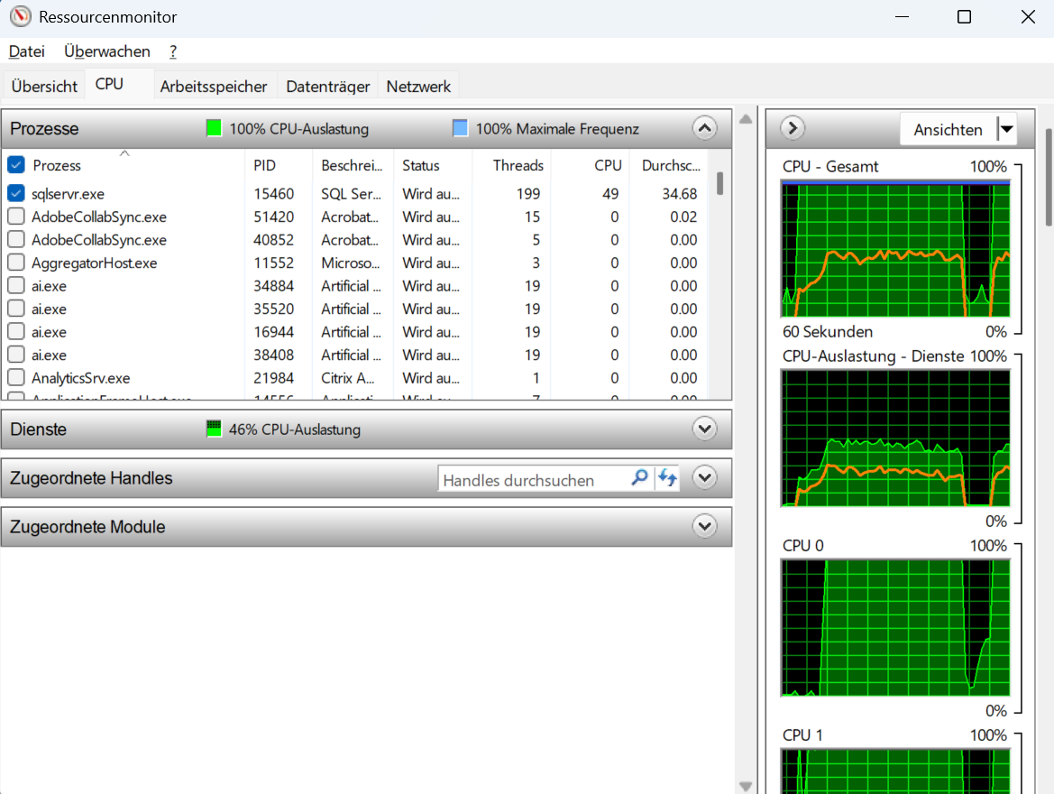
Make your SQL Code fast again
Objectives of this workshop
Identification of common SQL errors and their impact on performance.
Techniques to improve the efficiency of SQL queries.
Practical examples and best practices to improve performance.

Slide 7
Key Topics
Tools and best practices
using analysis and optimization tools
recommendations for improving query speed.
Detecting bad SQL code
Identifying inefficient queries and potential performance bottlenecks.
Optimization techniques
reducing hardware resources (CPU / IO)
reducing redundant queries
avoiding unnecessary joins
Using indexes

Slide 8
Tools and best practices
Query Store
Performance Monitor / Resource Monitor
Windows Admin Center
Third Party Tools
Redgate
Idera
Solarwinds
…

Slide 9
Query Store
Source Tool for Query Performance

Slide 10
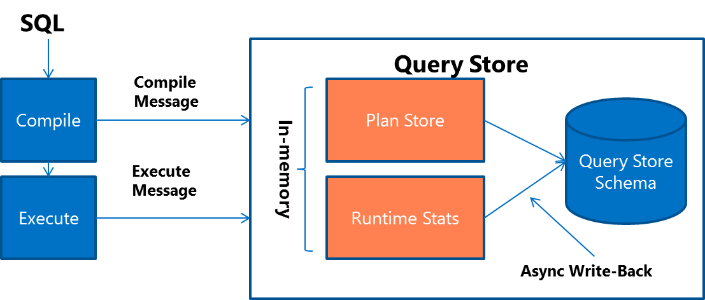
Query Store – Microsoft SQL Server
When a query gets compiled for the first time, query text and the initial plan are sent to Query Store.
When a query gets recompiled, the plan is updated in Query Store.
If a new plan is created, Query Store adds the new plan entry for the query and keeps the previous ones along with their execution statistics.
Upon the query execution, runtime statistics are sent to Query Store.
During the compile and check for recompile phases, SQL Server determines if there's a plan in Query Store that should be applied for the currently running query.

Slide 11
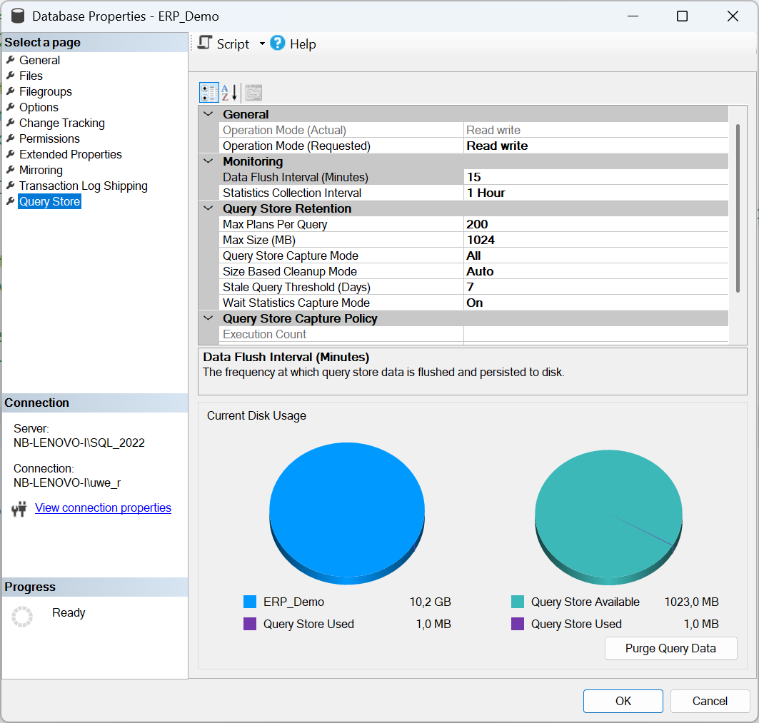
Query Store – Recommended Settings
Data Flush Interval 15 mins
Statistics Collector Interval 1 Hour
Max Size (MB) 1.024 MB
Query Store Capture Mode Auto
Stale Query Threshold 7 Days
Wait Statistics Capture Mode On

Slide 12
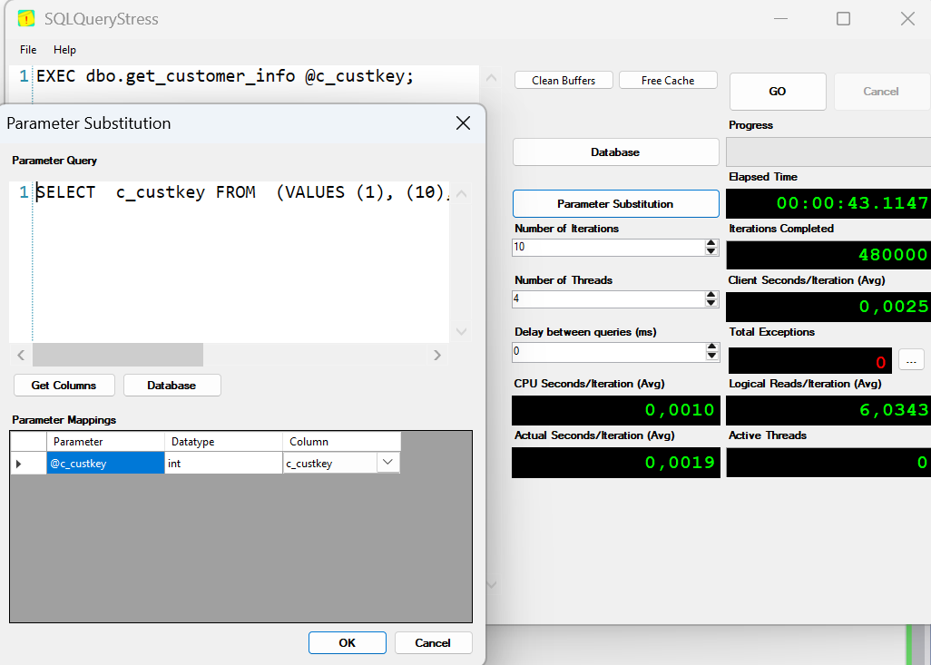
Query Store – Hands On/Demo
open the script 0001 – demo of Query Store.sql
follow the instructions of the instructor
start SQL Query Stress
Load the pre-configuratino set: 01 – demo of Query Store.json
follow the next instructions of the instructor see the different execution plans in Query Store

Slide 13
Performance Monitor Windows Admin Center
Source Tool for Resource Performance

Slide 14
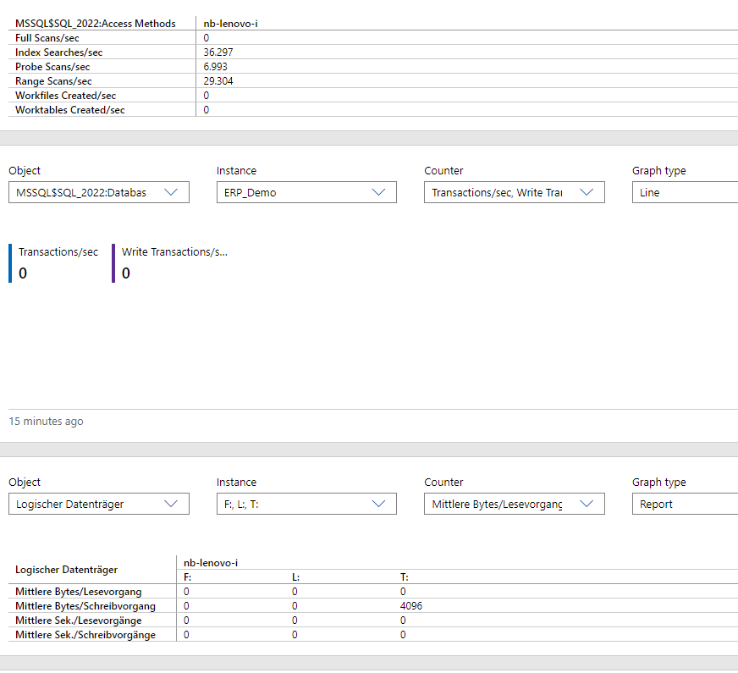
Windows Admin Center vs. PerfMon
Windows Admin Server
Windows Admin Center is generally more suitable for administrators looking for an all-in-one, user-friendly tool for managing multiple servers
ease of use
centralized management.
Performance Monitor
PerfMon remains a powerful tool for more in-depth, counter-specific monitoring on individual servers,
use may be limited to specific scenarios where detailed monitoring is required without needing broader server management features.
Use Windows Admin Center for day-to-day management
Use PerfMon as a specialized tool for deep performance diagnostics

Slide 15
Windows Admin Center – Hands On/Demo
open the script 02 – demo of Windows Admin Center.sql
follow the instructions of the instructor
start SQL Query Stress
Load the pre-configuration set: Windows Admin Center Demo.json
follow the next instructions of the instructor see the different execution plans in Query Store

Slide 16
Scenario #1
When functions don‘t function

Slide 17
Scenario 1 – Problem Description
Description
A job engine produces 24/7 for ~16.000.000 customers on a daily basis a class type calculation. Since lots of customers must be recalculated every day, the job engine is working with 20 simultaneous processes.
The developers are using a User Defined Function for the calculation of the class type!
Problem
If the job queue has a particularly large number of entries (> 1,000,000), performance drops and the system is no longer able to respond!
We observe high latency on the system database TEMPDB when the number of entries raise (correlation!).

Slide 18
Scenario 1 - Preparation
Demo Configuration
To demonstrate the problem, two tables ([dbo].[customers] and [dbo].[orders]) are used.
A user-defined function dbo.calculate_customer_category() is implemented.
It analyze the orders for a customer (identified by customer number ([c_custkey]) and categorizes the customer.
Demo Setup
execute the script 0001 - scenario 01 – preparation.sql to prepare [dbo].[customers] and [dbo].[orders] with indexes and Foreign Key References.
execute the script 0002 - scenario 01 - user defined function.sql to create the user defined function.
Execute the script 0003 - scenario 01 – sp_stress_test.sql to create the user defined function.

Slide 19
Scenario 1 - Findings
Avoid multiple manipulations on temporary objects This technique will reduce TEMPDB activity
Avoid NONSargable expressions and replace them with SARGable expressions NONSargable expressions will lead to
Residual predicates
FULL scans
Avoid to use SCALAR or Multiline functions and try to rewrite them as an Inline-Function. Inline Functions can be interpreted by the compiler as relational operations within the same query (like views – but with parameters!)

Slide 20
Scenario #2
Stop using table variables and temporary objects

Slide 21

Scenario 2 – Problem Description
Description
A software uses a table to queue jobs. Whenever a new job is to be queued, its details are written into this table. The table grows very quickly, as up to 100,000 jobs can be scheduled in one hour.
A stored procedure manage the deletion of executed jobs.
The first parameter specifies how many job entries should be deleted.
The second parameter specifies the batch size.
Problem
Sometimes the table is growing very fast and the maintenance job cannot scale.
The table is growing the system suffers from performance problems.

Slide 22
Scenario 2 - Workflow
@items
Singleguid
(TOP @rowlimit)
EXEC @return_value = dbo.jobqueue_delete
@rowlimit = 3000,
@maxlimit = 50000;
dbo.jobqueue
TOP (@maxlimit)
WHERE generation
@itemportion
Exit!
No
Rowcount > 0
UPDATE @items
DELETE dbo.jobqueue

Slide 23
Scenario 2 - Preparation
Demo Configuration
To demonstrate the problem, two tables ([dbo].[jobqueue] and [dbo].[runtime_statistics]) are used.
A stored procedure [dbo].[jobqueue_delete] handles the maintenance of the the table [dbo].[jobqueue].
The table [dbo].[runtimes] stores the measures after each improvement.
Demo Setup
execute the script 01 - scenario 02 – preparation.sql to prepare all table objects.
execute the script 02 - scenario 02 – maintenance procedure.sql to create the user management procedure.
Execute the script 03 - scenario 02 – stress query.sql to create the user defined function.

Slide 24
Scenario 2 - Findings
To check for data existence, use EXISTS instead of COUNT.
Remove unnecessary code structures for better reading and performance
Check indexes on the table and remove non used indexes
For multi-process patterns try to partition the job itself.

Slide 25
Scenario #3
Stop using table variables and temporary objects

Slide 26
Scenario 2 – Problem Description
Description
A complex query will be executed 24/7 when users are accessing the web shop. This query evaluates a small part of the permission list for the logged in user.
Problem
The query is consuming a lot of resources and especially at the first of a new month lots of new employees are requesting the web shop.
This leads very often to timeouts and bad responding web shop experiences.
dbo.persons
uid_person | varchar(38) | NOT NULL | PK
…
centralsapaccount | nvarchar(12) | NULL | NCI
ccc_aliasname | nvarchar(255) | NULL
OR
dbo.sapusers
uid_sapuser | varchar(38) | NOT NULL | PK
uid_person | varchar(38) | NULL
accnt | nvarchar(38) | NULL | NCI
ccc_aliasname | nvarchar(255) | NULL

Slide 27
Scenario 3 - Findings
Avoid creating too deep nesting with SUB-Selects. They are difficult to read and may not be ideally optimized by the Query Optimizer.
OR statements on different attributes cannot always be used optimally by the query optimizer, despite both attributes being indexed. This is especially true if the attributes have a similar selectivity (cardinality).
To use the indexes on the attributes efficiently, it is better to use UNION ALL instead of OR.

Slide 28
Performance optimization of badly written SQL code Enhancing Database Efficiency for Faster, More Scalable Applications
Uwe Ricken
https://github.com/uricken1964/Workshop---Making-Bad-Codes-Better

Slide 29
Uwe Ricken db Berater GmbH
I am working with IT-systems since early 1990's and with the main focus on Microsoft SQL Server since version 6.0. I started with development of database applications in 1998 with a professional CRM-System based on Microsoft products (Microsoft Office and Microsoft SQL Server).
Since 2008 I'm focused exclusively on Microsoft SQL Server and I was working in 3rd level support teams for enterprise companies, banks and insurances.
Since May 2013 I'm a Microsoft Certified Master: SQL Server 2008 which was an amazing way into the depth of Microsoft SQL Server.
In July 2013 I have been awarded with the MVP Award for Microsoft SQL Server.
www: http://www.db-berater.de
email: uwe.ricken@db-berater.de
blog: http://www.sqlmaster.de
LinkedIn: https://www.linkedin.com/in/uwericken

Slide 30
Break Times
09:00 – 10:30 Session
10:30 – 11:00 Coffee Break
11:00 – 12:30 Session
12:30 – 13:30 Lunch Break
13:30 – 15:00 Session
15:00 – 15:30 Coffee Break
15:30 – 16:45 / 17:00 Session

Slide 31
Action List
Download ERP_Demo Database https://www.db-berater.de/downloads/ERP_DEMO_2012.BAK
Download Workshop Solution https://github.com/uricken1964/Workshop---Making-Bad-Codes-Better
Open the SSMS Project File in SSMS
Execute the following scripts
0000 - dbo.sp_restore_erp_demo.sql
0002 - Preparation of demo databases.sql
Check the version of the demo database SELECT * FROM ERP_Demo.dbo.get_database_help_info();;

Slide 32
Make your SQL Code fast again
Why is SQL optimization important?
Performance Improvement
Efficient SQL code enhances database performance by reducing execution time and resource consumption.
Resource Utilization
Optimized SQL queries use fewer system resources like CPU, memory, and disk I/O for better scaling.
Scalability
Efficiently written SQL code can better handle increased data volume and user load.
Cost Savings
Reduced resource usage translates to cost savings, especially in cloud environments.
Reliability and Stability
Efficient queries are less likely to cause unexpected issues, such as timeouts or server crashes.

Slide 33
Make your SQL Code fast again
Objectives of this workshop
Identification of common SQL errors and their impact on performance.
Techniques to improve the efficiency of SQL queries.
Practical examples and best practices to improve performance.

Slide 34
Key Topics
Tools and best practices
using analysis and optimization tools
recommendations for improving query speed.
Detecting bad SQL code
Identifying inefficient queries and potential performance bottlenecks.
Optimization techniques
reducing hardware resources (CPU / IO)
reducing redundant queries
avoiding unnecessary joins
Using indexes

Slide 35
Tools and best practices
Query Store
Performance Monitor / Resource Monitor
Windows Admin Center
Third Party Tools
Redgate
Idera
Solarwinds
…

Slide 36
Query Store
Source Tool for Query Performance

Slide 37
Query Store – Microsoft SQL Server
When a query gets compiled for the first time, query text and the initial plan are sent to Query Store.
When a query gets recompiled, the plan is updated in Query Store.
If a new plan is created, Query Store adds the new plan entry for the query and keeps the previous ones along with their execution statistics.
Upon the query execution, runtime statistics are sent to Query Store.
During the compile and check for recompile phases, SQL Server determines if there's a plan in Query Store that should be applied for the currently running query.

Slide 38
Query Store – Recommended Settings
Data Flush Interval 15 mins
Statistics Collector Interval 1 Hour
Max Size (MB) 1.024 MB
Query Store Capture Mode Auto
Stale Query Threshold 7 Days
Wait Statistics Capture Mode On

Slide 39
Query Store – Hands On/Demo
open the script 0001 – demo of Query Store.sql
follow the instructions of the instructor
start SQL Query Stress
Load the pre-configuratino set: 01 – demo of Query Store.json
follow the next instructions of the instructor see the different execution plans in Query Store

Slide 40
Performance Monitor Windows Admin Center
Source Tool for Resource Performance

Slide 41
Windows Admin Center vs. PerfMon
Windows Admin Server
Windows Admin Center is generally more suitable for administrators looking for an all-in-one, user-friendly tool for managing multiple servers
ease of use
centralized management.
Performance Monitor
PerfMon remains a powerful tool for more in-depth, counter-specific monitoring on individual servers,
use may be limited to specific scenarios where detailed monitoring is required without needing broader server management features.
Use Windows Admin Center for day-to-day management
Use PerfMon as a specialized tool for deep performance diagnostics

Slide 42
Windows Admin Center – Hands On/Demo
open the script 02 – demo of Windows Admin Center.sql
follow the instructions of the instructor
start SQL Query Stress
Load the pre-configuration set: Windows Admin Center Demo.json
follow the next instructions of the instructor see the different execution plans in Query Store

Slide 43
Scenario #1
When functions don‘t function

Slide 44
Scenario 1 – Problem Description
Description
A job engine produces 24/7 for ~16.000.000 customers on a daily basis a class type calculation. Since lots of customers must be recalculated every day, the job engine is working with 20 simultaneous processes.
The developers are using a User Defined Function for the calculation of the class type!
Problem
If the job queue has a particularly large number of entries (> 1,000,000), performance drops and the system is no longer able to respond!
We observe high latency on the system database TEMPDB when the number of entries raise (correlation!).

Slide 45
Scenario 1 - Preparation
Demo Configuration
To demonstrate the problem, two tables ([dbo].[customers] and [dbo].[orders]) are used.
A user-defined function dbo.calculate_customer_category() is implemented.
It analyze the orders for a customer (identified by customer number ([c_custkey]) and categorizes the customer.
Demo Setup
execute the script 0001 - scenario 01 – preparation.sql to prepare [dbo].[customers] and [dbo].[orders] with indexes and Foreign Key References.
execute the script 0002 - scenario 01 - user defined function.sql to create the user defined function.
Execute the script 0003 - scenario 01 – sp_stress_test.sql to create the user defined function.

Slide 46
Scenario 1 - Findings
Avoid multiple manipulations on temporary objects This technique will reduce TEMPDB activity
Avoid NONSargable expressions and replace them with SARGable expressions NONSargable expressions will lead to
Residual predicates
FULL scans
Avoid to use SCALAR or Multiline functions and try to rewrite them as an Inline-Function. Inline Functions can be interpreted by the compiler as relational operations within the same query (like views – but with parameters!)

Slide 47
Scenario #2
Stop using table variables and temporary objects

Slide 48
Scenario 2 – Problem Description
Description
A software uses a table to queue jobs. Whenever a new job is to be queued, its details are written into this table. The table grows very quickly, as up to 100,000 jobs can be scheduled in one hour.
A stored procedure manage the deletion of executed jobs.
The first parameter specifies how many job entries should be deleted.
The second parameter specifies the batch size.
Problem
Sometimes the table is growing very fast and the maintenance job cannot scale.
The table is growing the system suffers from performance problems.

Slide 49
Scenario 2 - Workflow
@items
Singleguid
(TOP @rowlimit)
EXEC @return_value = dbo.jobqueue_delete
@rowlimit = 3000,
@maxlimit = 50000;
dbo.jobqueue
TOP (@maxlimit)
WHERE generation
@itemportion
Exit!
No
Rowcount > 0
UPDATE @items
DELETE dbo.jobqueue

Slide 50
Scenario 2 - Preparation
Demo Configuration
To demonstrate the problem, two tables ([dbo].[jobqueue] and [dbo].[runtime_statistics]) are used.
A stored procedure [dbo].[jobqueue_delete] handles the maintenance of the the table [dbo].[jobqueue].
The table [dbo].[runtimes] stores the measures after each improvement.
Demo Setup
execute the script 01 - scenario 02 – preparation.sql to prepare all table objects.
execute the script 02 - scenario 02 – maintenance procedure.sql to create the user management procedure.
Execute the script 03 - scenario 02 – stress query.sql to create the user defined function.

Slide 51
Scenario 2 - Findings
To check for data existence, use EXISTS instead of COUNT.
Remove unnecessary code structures for better reading and performance
Check indexes on the table and remove non used indexes
For multi-process patterns try to partition the job itself.

Slide 52
Scenario #3
Think set based but not row based!

Slide 53
Scenario 3 – Problem Description
Description
The management board wants to have on a daily basis a report by region for the last three orders from any customer placed in a given time range.
The development team created a stored procedure with two parameters:
@date_from DATE
@date_to DATE
Problem
The business complains about a bad performance of more than 40 seconds for the execution.
Sometimes the business is receiving timeout errors.
dbo.persons
uid_person | varchar(38) | NOT NULL | PK
…
centralsapaccount | nvarchar(12) | NULL | NCI
ccc_aliasname | nvarchar(255) | NULL
OR
dbo.sapusers
uid_sapuser | varchar(38) | NOT NULL | PK
uid_person | varchar(38) | NULL
accnt | nvarchar(38) | NULL | NCI
ccc_aliasname | nvarchar(255) | NULL

Slide 54
Scenario 3 - Findings
Avoid DDL commands outside of the table definition itself for Temporary Tables. This leads to recompiles!
Analyze the Query Store to identify useful indexes for better performance
Don’t use cursors because we want to process rows set based but not row based!
Try to write the process in ONE query for best performance.

Slide 55
Scenario #4
Triggers, Functions, … - Exodus!

Slide 56
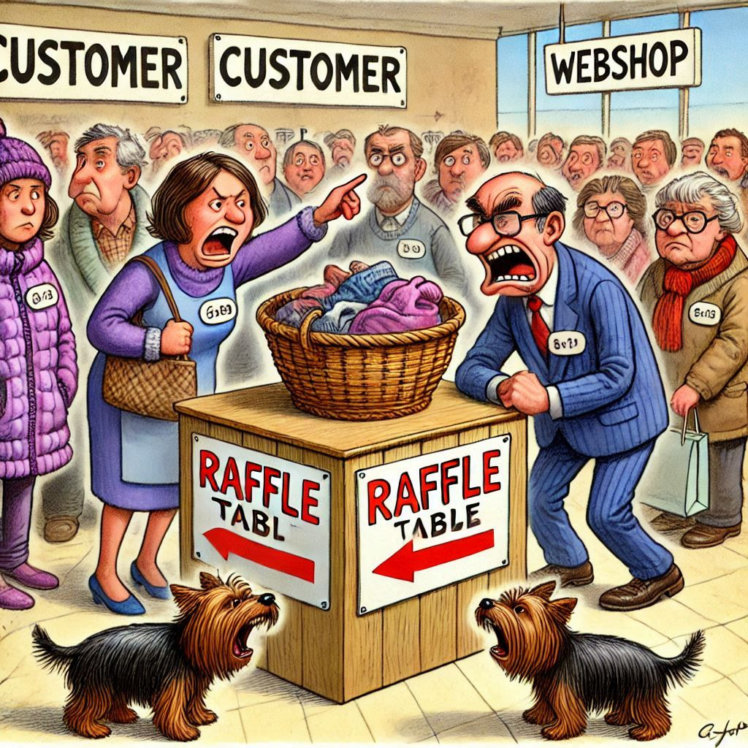
Scenario 4 – Problem Description
Description
A customer's web shop runs without any complaints from customers during "normal" days.
As soon as special sales promotions are started (e.g. Black Friday, fire sale, ...), the system's performance collapses and customers complain that it takes a long time for placing an order in the system.
Problem
During peak times, the system reacts very slowly and cannot be used in some cases.
Customers often abandon their purchase attempts in frustration.
OR

Slide 57




Scenario 4 - Workload
webshop.insert_order
SQL
webshop.customers
webshop.orders
webshop.lineitems
webshop.update_order
webshop.delete_order
Job Server

